Slide 1
Digital Communication 24EC2208
Digital Carrier Modulation

Slide 2
Binary Frequency Shift Keying (BFSK)

Slide 3
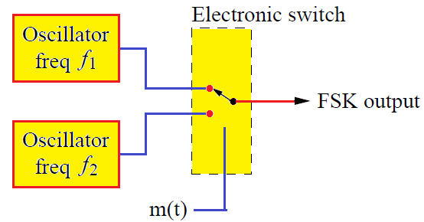
Binary Frequency Shift Keying (BFSK)
Frequency Shift Keying is analogous to Frequency Modulation (FM) in analog domain, where the slope of the time varying angle of the signal, i.e., instantaneous frequency of the carrier signal varies with respect to the baseband signal.
In unipolar or bipolar formatting of the digital symbol, there exist two amplitude levels defined for two logic values one and zero.
Therefore, two sinusoidal carrier waves of the same amplitude A_{c} but different frequencies f₁ and f₂ are used to represent the two symbols.

Slide 4
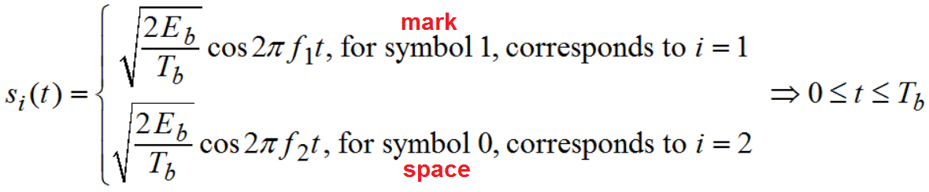
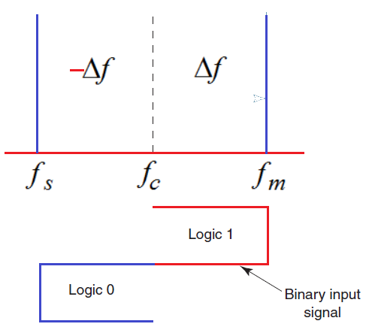
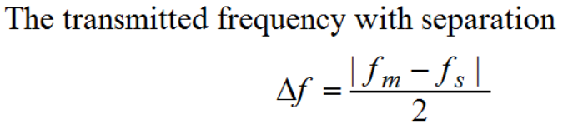

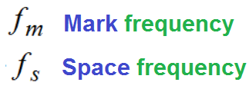
Mathematical Model

Slide 5
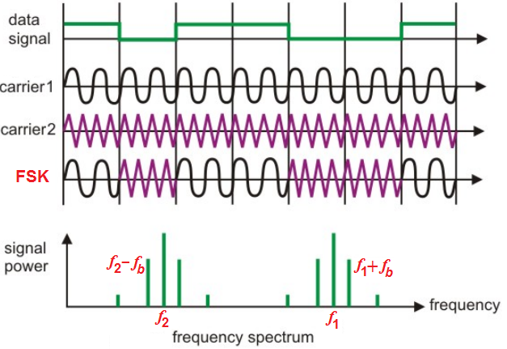

Slide 6
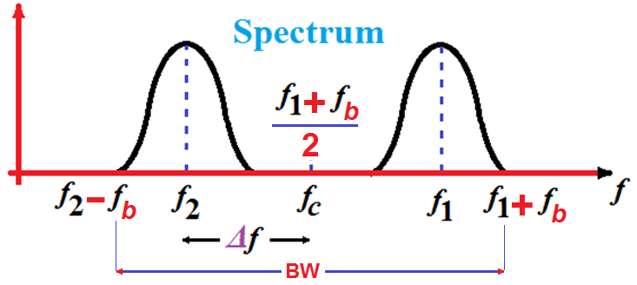

Bandwidth of FSK
Bandwidth =
Carson’s rule

Slide 7
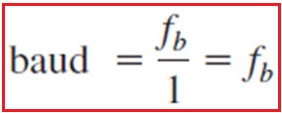
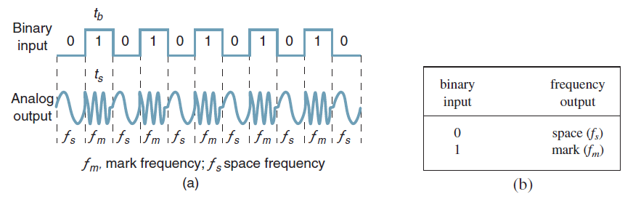
Baud, Bit rate and Bandwidth of FSK
In Fig (a), it can be seen that the time of one bit (t_{b}) is the same as the time the FSK output is a mark of space frequency (t_{s}).
Thus, the bit time equals the time of an FSK signaling element, and the bit rate equals the baud.

Slide 8
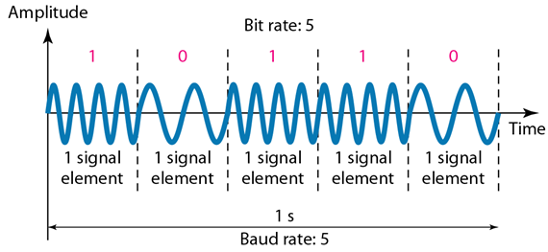

Slide 9
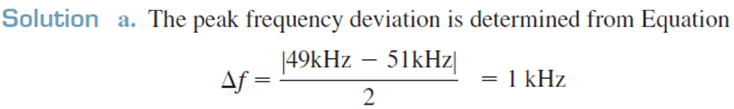
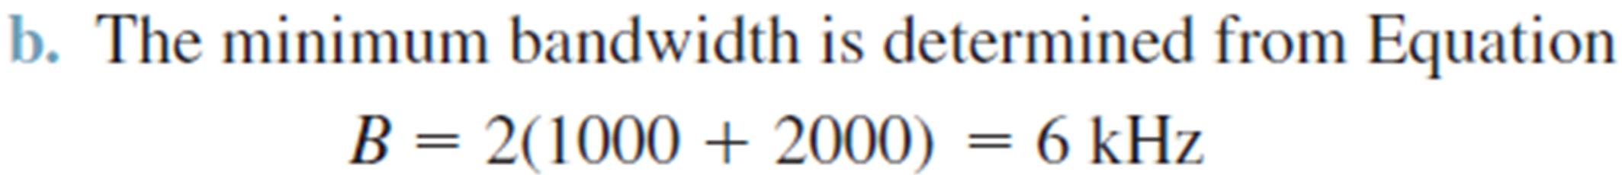
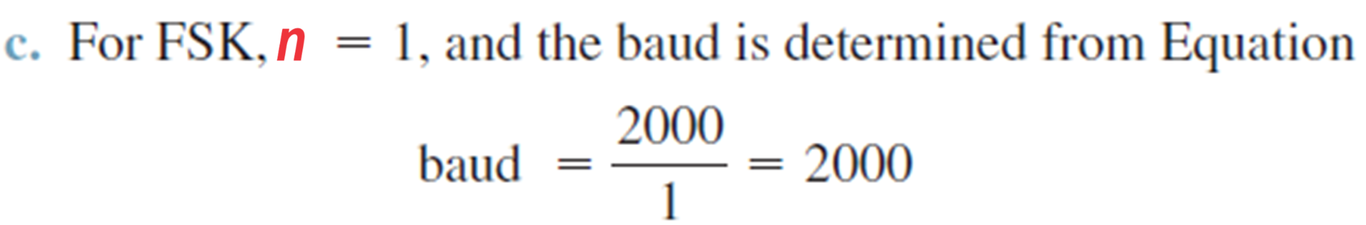
Ex1: Determine (a) the peak frequency deviation, (b) minimum bandwidth, and (c) baud for a binary FSK signal with a mark frequency of 49 kHz, a space frequency of 51 kHz, and an input bit rate of 2 kbps.

Slide 10
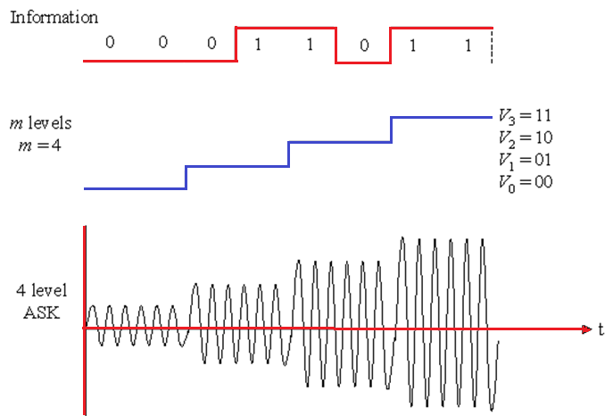
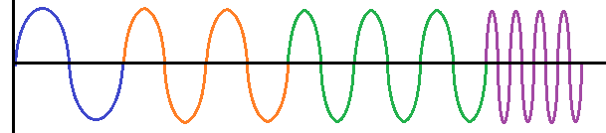
4 level FSK

Slide 11
Bandwidth for M-ary FSK

Slide 12
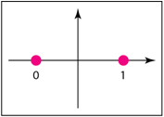
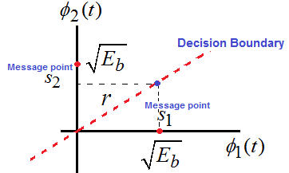
Signal Space Representation

Slide 13
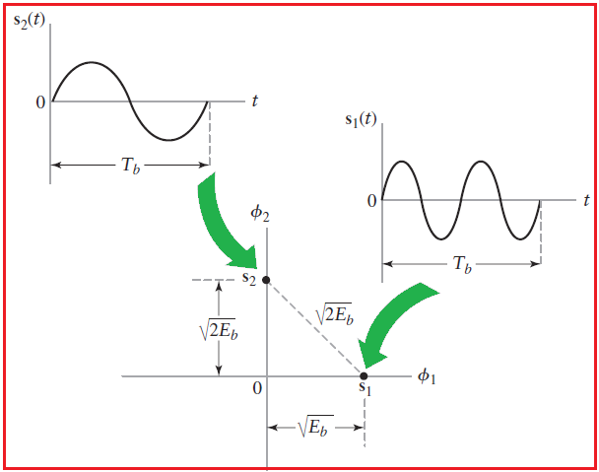

Slide 14
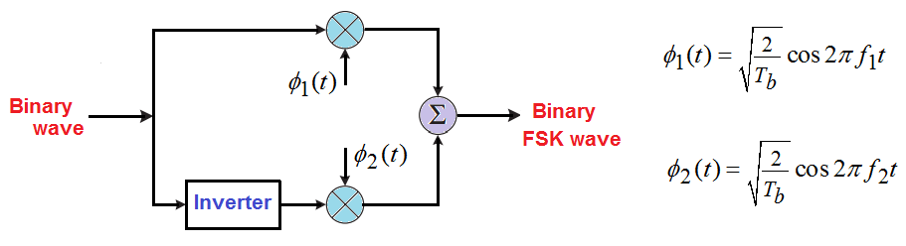
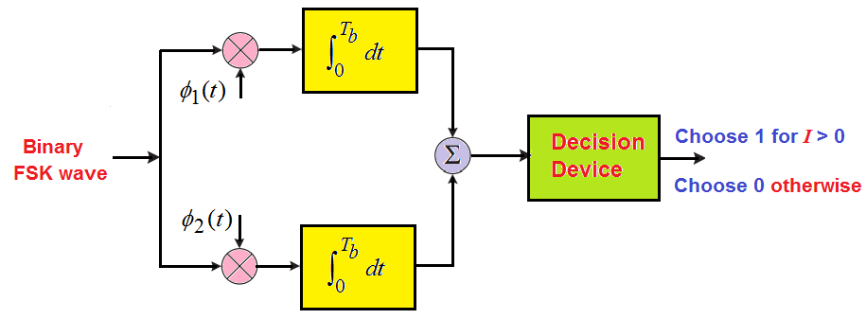
BFSK Transmitter and Receiver

Slide 15
Bit Error Rate for BFSK
The average probability of error

Slide 16
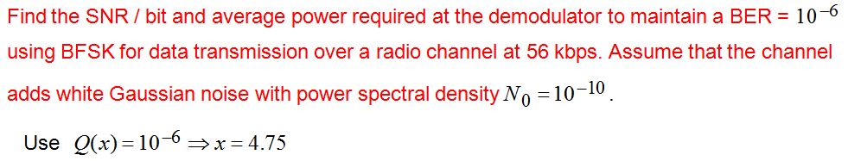

Slide 17
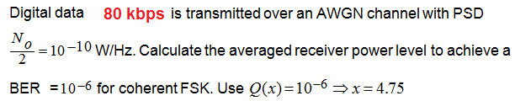

Slide 18
Advantages of FSK:
FSK is ideally a constant envelope modulation; hence, more power-efficient class-C non-linear Power Amplifiers can be used in the transmitter.
FSK is more bandwidth efficient than ASK.
Reasonably simple modulation and demodulation schemes.
Disadvantages of FSK:
The difference between coherent FSK detection and non-coherent FSK detection is not significant for higher FSK levels.
The extra hardware required for coherent FSK detection is hence hard to justify.
Coherent FSK is not often used in practice due to the difficulty (and cost) in generating two reference frequencies close together at the receiver.

Slide 19
End

